Slide 1
RAG for transcripts
Sebestyén Pap

Slide 2
Project details
Context:
I was a member of a student organization of social scientists, now part of the alumni
About 20 years of weekly meetings transcribed by hand
Objective:
To make it searchable by people, issues and time.
To extract key partners. Explore network of contacts.

Slide 3
Graph RAG Basics
Boci et al., 2024 aug

Slide 4
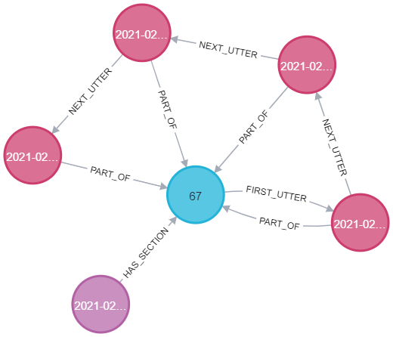
Document structure
Sections are hierarchically organized Chunks are utterings from participants in a section.
-> A retrieval returns utter(s), section or node properties

Slide 5
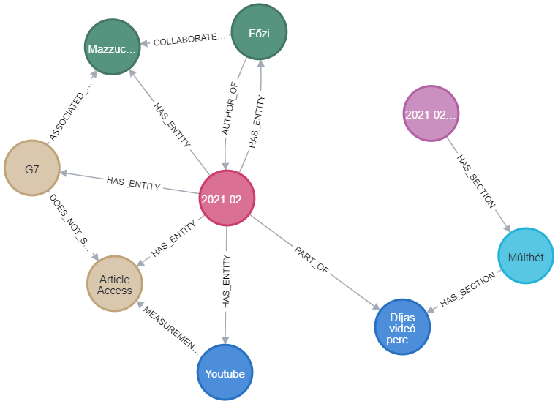
Chunking- utters
Example:
„Subject: Múlthét – Díjas videó percek Péter: Mazzucatonal volt, hogy g7 nem akarta megosztani az eléréseiket, youtubnál jobb mérőszámot nem nagyon tudunk szerezni, nekem az jön le, hogy a cikk elérés is olyan dolog, hogy nem szoktak cikkenként megosztan ilyen dolgokat, nem biztos, hogy így működik” Should more context be included?

Slide 6
Knowledge graph generation
Generate entities and relationships:
From Hungarian text – keep named entities
With pretranslation – deeper understanding
Entity disambiguation:
Example: {„Nagy Máté”, „Máté”, „NM”, „NMáté”} => „Nagy Máté”
Ground truth data:
Known authors - Example: „Máté: Azt gondolom hogy…”
Administrative data

Slide 7
Knowledge graph generation

Slide 8
Retriever
Main idea:
Store the data in neo4j
Write cypher queries with llm -> few shot prompting
Results can be:
Nodes, Triplets, Paths, Subgraphs, Hybrid

Slide 9
Further directions – From Local to Global
Darren et al., 2024 apr.

Slide 10
Thank you!

