Slide 1
Graph Neural Networks for traffic modeling
Máth Benedek, Nemes Ádám

Slide 2
Our Goals
Give an estimate for the future of trafic density on the edges, based on 30% of the edge data

Slide 3
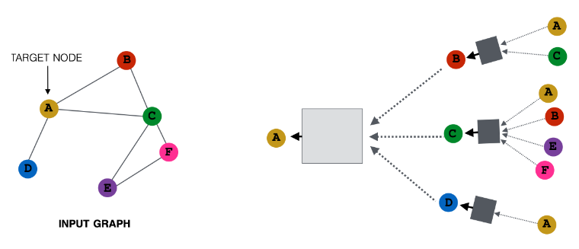
GNN – Graph Neural Networks

Slide 4
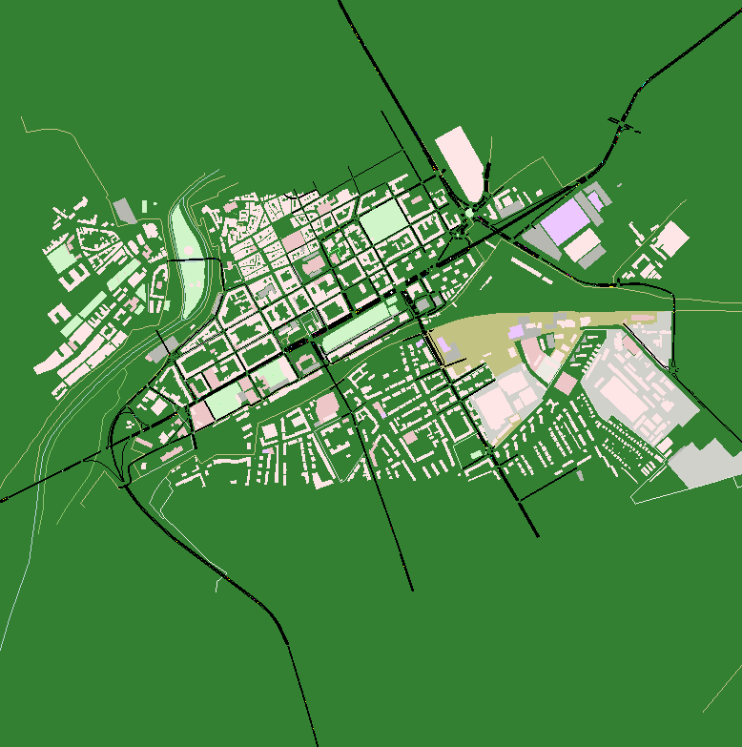
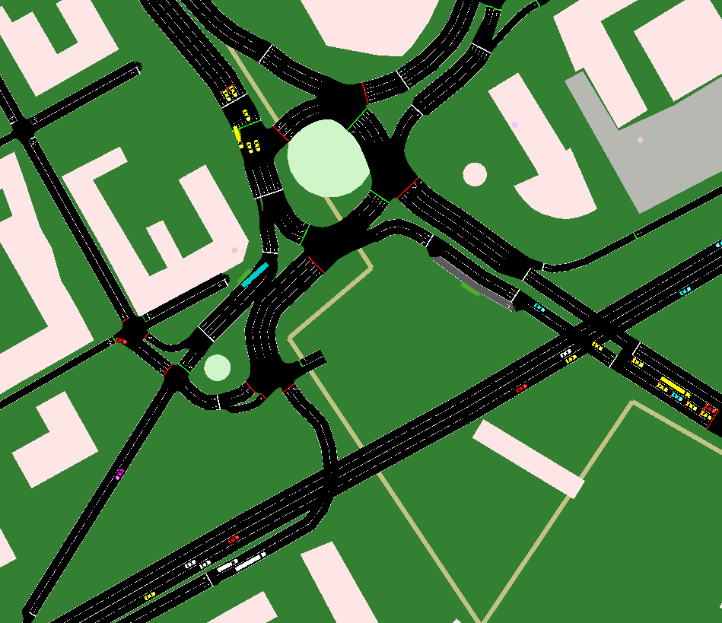
What is SUMO?
Notes:
Sumo is a traffic simulator, witch simulates every car with its position speed ect. We are using the edge data-s to train our GNN.

Slide 5
SUMO operates on a microscopic level, meaning it simulates the behavior of individual vehicles in a network. This includes aspects like lane-changing, acceleration, and interactions with traffic lights and other vehicles.

Slide 6
Our Trafic system

Slide 7
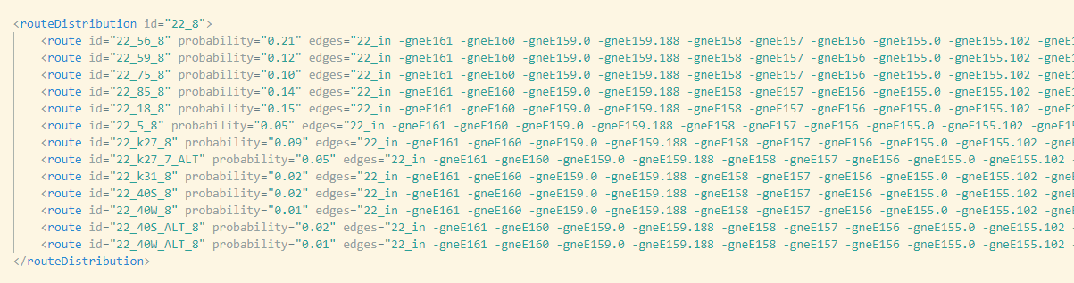
How does the cars move?
Assigning Vehicles to Routes
Generating Departure Times
Simulating Vehicle Movements
Traffic Control (traffic signals, stop signs, and other road rules)

Slide 8
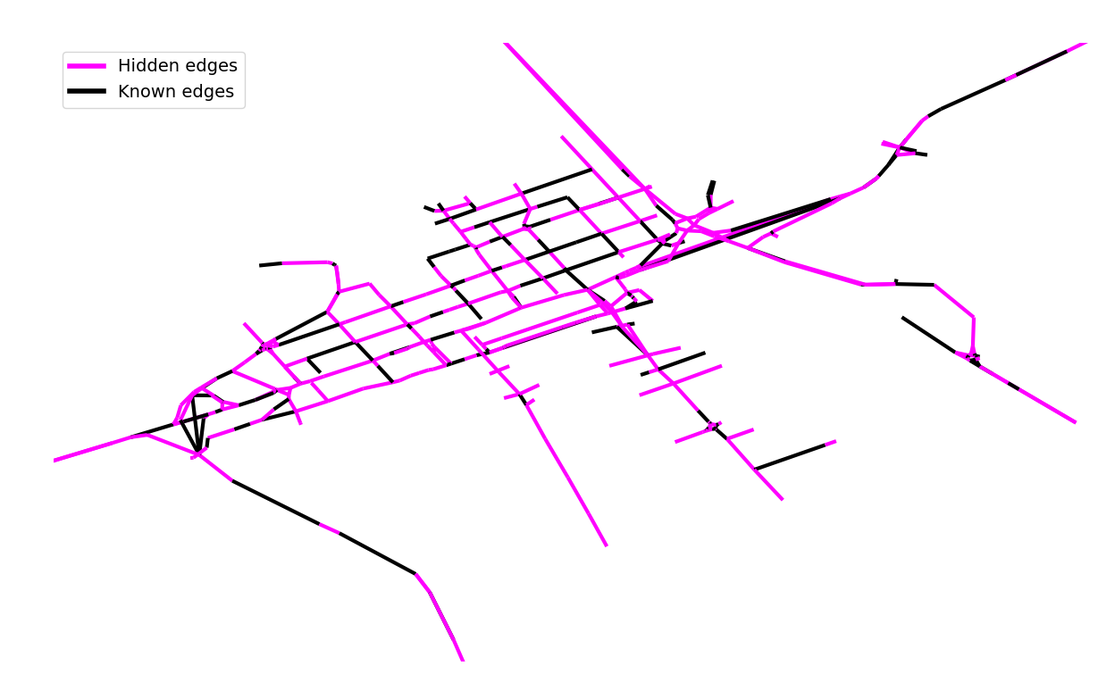
Modelling traffic
In real world cases, only about 10% of roads have traffic volume measuring sensors
We decided to aim for 30% of known roads, 70% of unknown roads as it is more within reach for one semester
We chose the known roads randomly
Our model was simple, 8 GCN and 1 dense layer

Slide 9
Thank You for your attention!

