Slide 1
Fingerprint project
Boros Réka, Czakó Adrienn, Bárdos-Deák Botond, Kránitz Bence

Slide 2




Our dataset
Sokoto Coventry Fingerprint Dataset (can be found on kaggle)
made up of nearly 6 000 fingerprint images from 600 subjects
Real and altered fingerprints (easy, medium, hard)
Original
Central rotation
Obliteration
Z-cut

Slide 3
Preparing the data
We have pictures and file names
All of the labels are coded in its name
100__M_Left_index_finger.BMP
100__M_Left_index_finger_CR.BMP

Slide 4
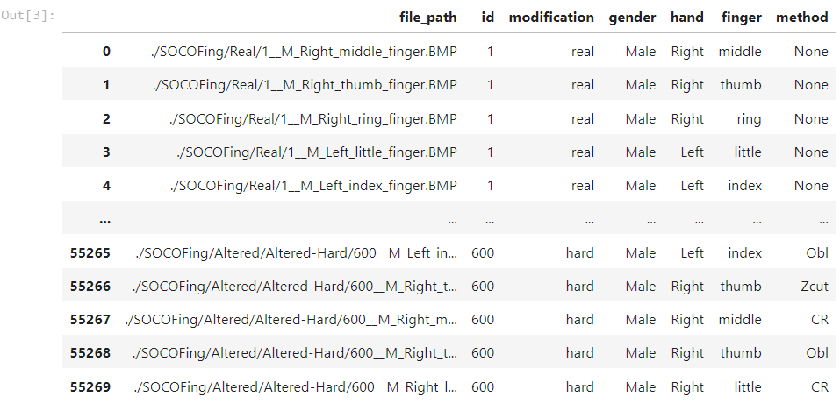

Slide 5
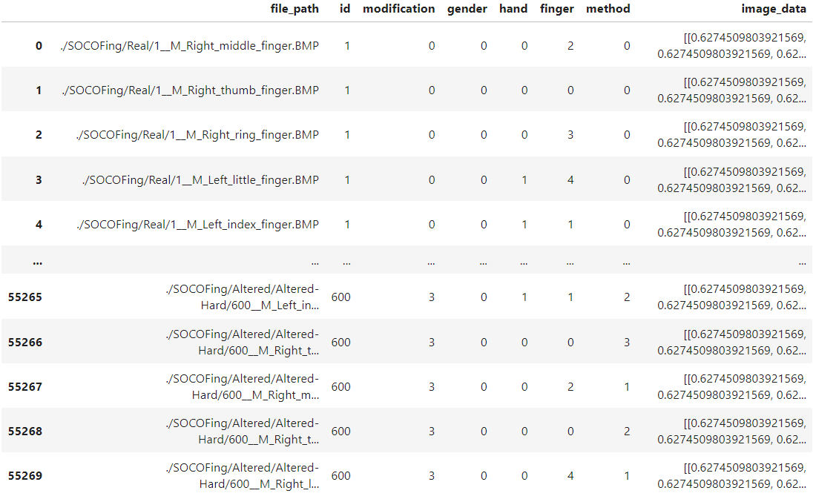

Slide 6
Our goals
Fingerprint recognition
Gender prediction
Finger detection

Slide 7
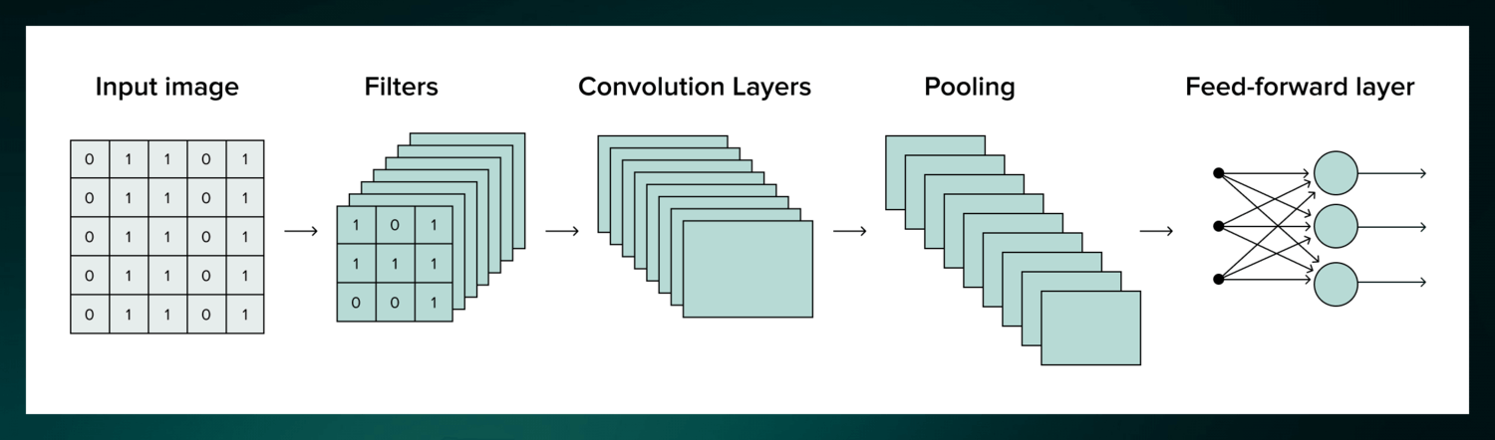
Baseline models – Finger detection
Data splitting
Knn algorithm
Randomforest method
CNN Accuracy: 70%

Slide 8
Splitting the data
To predict the gender and left or right hand, we split the data by the identities of the subjects.
  The first 500 subjects were part of the training data,
  From 500 to 550 were the validation data.
  From 550 to 600 was the test data.
To predict the correct ID of the people, we picked one image from each person in the test and validation sets, and the rest were in the training set.

Slide 9
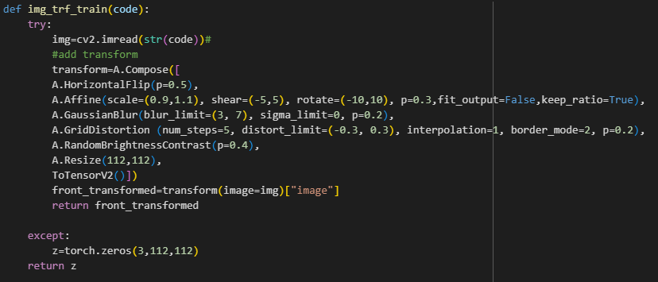
Image preprocessing
For the training we apply transformations:
  Horizontal flip with 0.5 probability
  Affine transformation with 0.3 probability
  Gaussian Blur with 0.2 probability
  Grid distortion with 0.4 probability
  Random brightness and contrast change with 0.4 probability
  And all pictures resized to 112x112

Slide 10
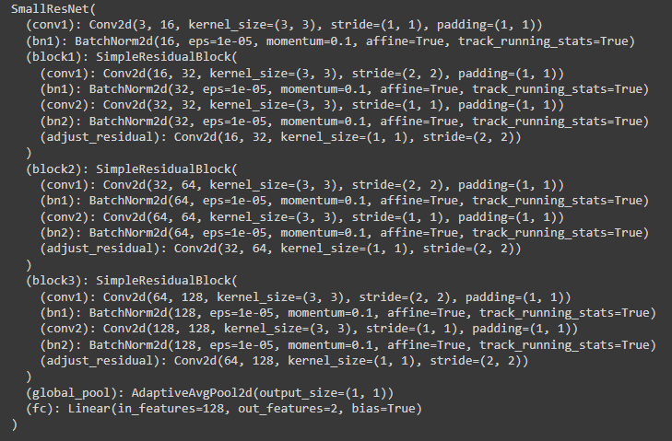
Cnn model
  We used a simplified ResNet model, which is a very common and effective one for image classification tasks.
  It works for us because we can achieve pretty good accuracy in all models on the first try.

Slide 11
First results
For predicting the gender we have 85% accuracy
For predicting the side of the hand we have 84% accuracy
For predicting the id of a person we have 70% accuracy
Further aims:
We would like to improve the accuracy of these models.
We wolud like to add a new model, which predict which finger is on the image.

