Slide 1

AML project
Otelo Gallego and Guillermo Gómez

Slide 2

Goal of the project
We want to predict whether each sentence of a text finishes in "?","!" or "."
PREDICTIONS:
First sentence ends with “.”
Second sentence ends with “?”
.
.
.
Last sentence ends with “.”
Compare with the real endings of the senteces to get the accuracy

Slide 3
Our idea
We define the following characteristics that we will introduce to the classifier so we can obtain a description of the sentences that can help us predict the symbol at the end:
Length of the sentence (including spaces and characters).
Number of words.
Number of words with one, two, three and more than six letters (four characteristics).
Number of letters
Number of capital letters.
Number of vowels
Number of accentuated vowels (for Spanish) considering capital ones as well.
Number of punctuation signs (3 separate characteristics): comas, colons and semicolons.

Slide 4
Have into account
In Spanish, we need to be careful with the sentence-initiating symbols "¿" and "¡" , since they can act as the final dot of the previous sentence.
We have only tried our code for small texts, not larger texts from books.
Usually, there are phrases that can be interpreted as a type that they are not.
For example: “I don´t know what you name is.’ could be predicted as a question but it is a simple phrase.

Slide 5
Other changes we want to add or try
Instead of using discrete numbers, making it continious by considering the proportions.
For example: instead of number of vowels, using the proportion of the letters which are vowels
We have tried it, but the results have not been that good

Slide 6
Explanation of the code

Slide 7
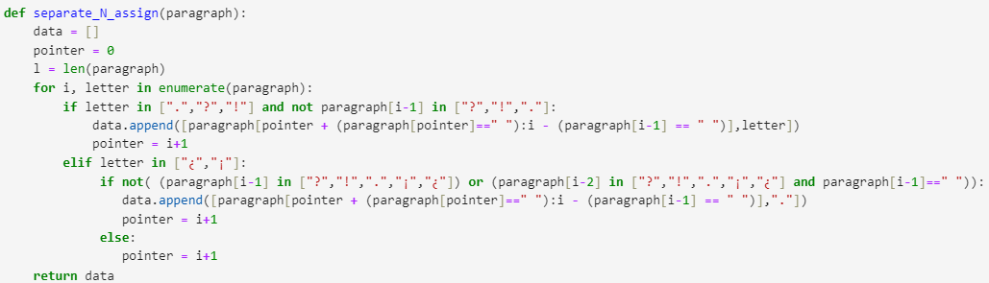
Load and organice data
Read a txt file separating paragraphs.
Separate sentences and remove ending punctuation

Slide 8
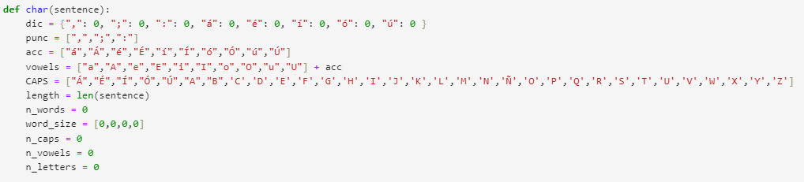
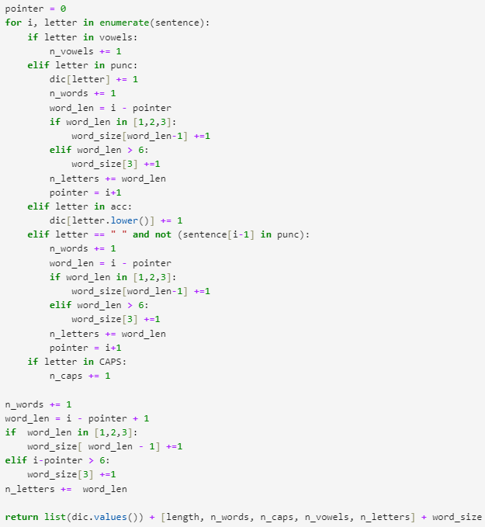
Assign characteristics to a sentence

Slide 9
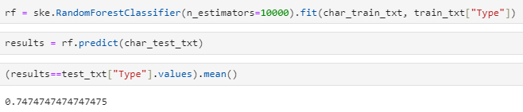
Classify Data and accuracy

Slide 10
Other changes we want to add or try
Trying other classifiers so maybe we can obtain better results.
Use a big text to train the classifier
Reduce dimension of characteristics or find more effective ones.

